Slide 1
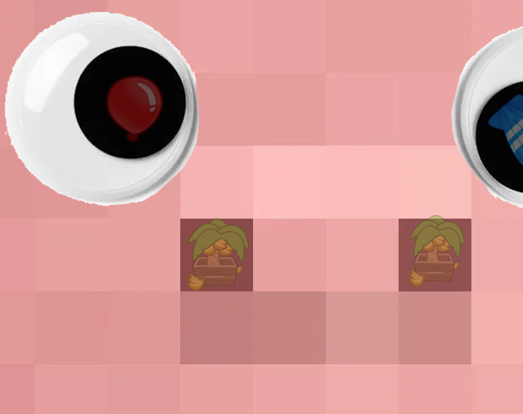
01-T2 Minecraft Game Mode
CS 4850 | Section 03 Spring 2025 | April 28th Professor Sharon Perry
Ashley Ahn
Matthew Elledge
AnnaGrace Gwee
Bryan Nguyen
Logan Slicker

Slide 2
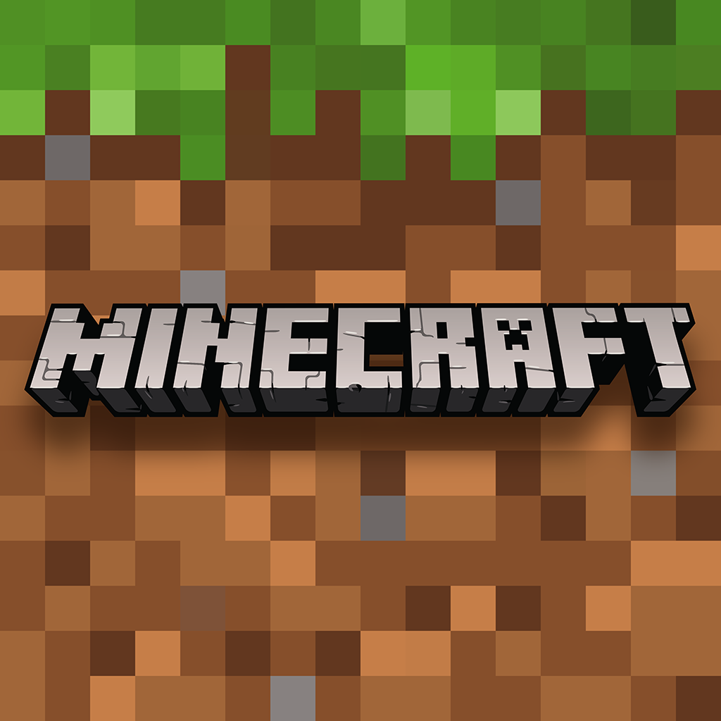
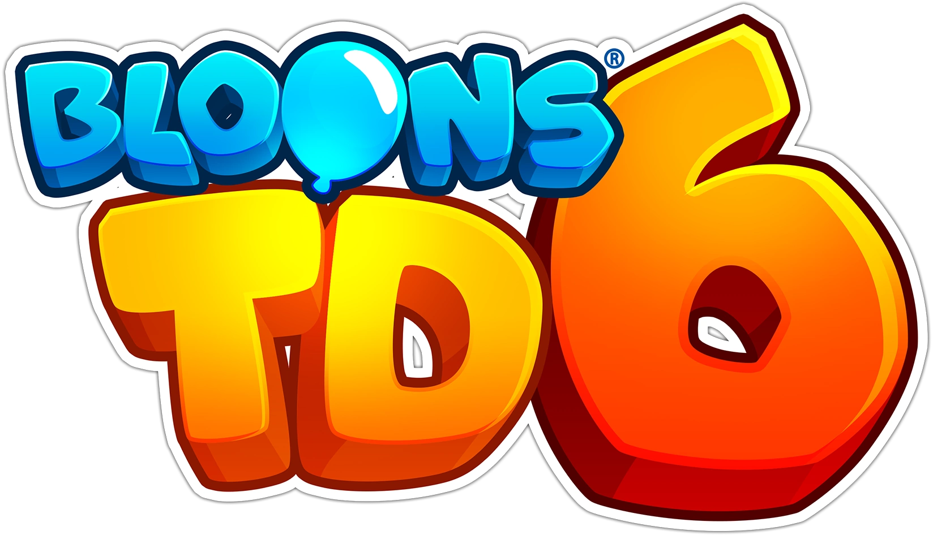
Preface
The KSU Minecraft server hosts many game modes and is looking for more: Thus, our game mode: KSUBlocks Tower Defense!
Our project's goal was to create a game within the Tower Defense Genre with inspired elements from BloonsTD6 and Sanctum 2, alongside our own takes and additions to it while fully supporting future development.

Slide 3
Overview
Requirements
Milestones (1 | 2 | 3)
Functional
Non-Functional
Analysis & Design
Tools & Dependencies
General Constraints
Architectural Drawings
Database Connection
Development
Planning & GDD
Gameplay & Mechanics
Software Test Plan & Report (STP & STR)
Finalized Items
GitHub Website
Completed Game

Slide 4
Requirements

Slide 5
Requirements - Milestones
Milestone 1
Draft the Game Design Document (GDD)
Command structure & permissions defined
Planned libraries
Consider game mechanics, rules, and multiplayer function
Plan on if the world or maps would be used and how
General information believed necessary to the staff
GitHub Repository & IDEs
Set up to begin coding after GDD approval
Milestone 2
​Asynchronous Processes
Verified that processes were handled off the main thread with an async function call
Code is fully documented with explanations​ for code practices
Basic Prototype​
Basic model of the tower defense genre (functional towers and incoming enemies) showcased​
Maps Designed
Two fully functional maps and two rough draft maps were released
Milestone 3
Polish & User Friendly
User Interfaces to maps, towers, and players added
All four maps finalized with Hub zone added with leaderboard
Bug Testing and Playtesting
Bugs removed and improved demo showcased at C-Day
Documentation
All artifacts on GitHub Home Page
Full documentation for players and admins on GitHub Wiki
Text

Slide 6
Requirements - Functional
Map Selection: The game is designed to handle map selection (through a GUI) and work with all four base-release maps alongside a hub zone (with a leaderboard) to send players to before and after games.
Round Management: The game state is prepared upon map selection and allows the player to ready up to begin active gameplay (combat) or wait while player does passive gameplay (towers & upgrades). All functions the round calls are also asynchronous for overall server performance and functionality.
Mob Management: Mobs are directed to follow the waypoints set to them. Upon reaching the end of their path, properly remove a player heart. Alternatively, upon defeat, mobs supply income to players, split if there is more than one player. Unique attributes, namely effect auras, are properly allocated to the right mobs.
Tower Management: Towers can be built once players have enough coins to build them through the compass GUI. Towers can also be upgraded with their own GUI. Towers also properly provide income to the player who owns said tower and tracks mobs on the path accurately.
Player Management: Players are capable of fighting mobs, upgrading their own stats, and building towers. Players are also supplied the necessary GUI calls and leaderboard updates for gameplay.

Slide 7
Requirements - Non-Functional
Capacity: The game can properly run on any paper server, so long as they match the right Java version (1.21.4). This can be updated through modifying the plugin before rebuilding it, but currently is designed to support the latest Minecraft Java edition. The game should also be lightweight to handle higher rounds with increased and varying mob spawning alongside multiple player actions. This is accomplished through asynchronous code and utilizing the base game's architecture.
Usability: The game needs to be easy to implement for developers and Minecraft servers while being easy to understand for both admins and players. As the Repo for the game is fully open source, developers can fully modify the game as needed. Documentation on the GitHub Wiki also ensures that both admins and players can read the information necessary to meet their experience requirements.
Modifiability: The game should allow for full customization: This is completed through the config.yml allowing for full modification to any and all aspects of the base game. This includes stats, income, effects, basic additions and removal, and so on. Balance and new additions are easily added to the game with the functions allowing for modular code.

Slide 8
Analysis & Design

Slide 9
A&D – Tools & Dependencies
Plugins
Parties – Creates the party system for multiplayer
PlaceholderAPI – Displays plugin information uniformly for servers
SimpleScore – Creates the leaderboard system for the game
APIs
Paper – The platform for many modded Minecraft servers
Parties
PlaceholderAPI
IntelliJ MC Dev Plugin
The basis for Minecraft Plugins

Slide 10
A&D – General Constraints
Asynchronous: The game needs to utilize asynchronous tasks for saving/keeping data that is less important or time sensitive to ensure that the main processing thread is open and unblocked. Latency issues should be avoided.
Configurable: The game, as stated before in non-functional requirements, should be configurable for future maintenance or changes as needed by server staff. This is accomplished with detailed documentation, code comment explanations, and easy to use functions.
Performance: Of course, the game should run smoothly with no issues during gameplay. There should also be no issues once hosted on the KSU MC server with the other game modes. Code should be neat and efficient to highlight this.

Slide 11
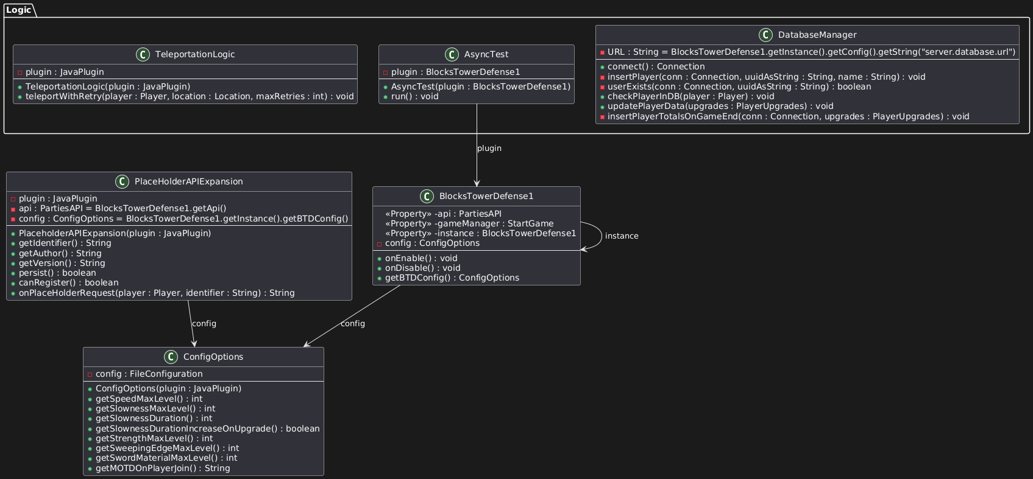
A&D – Architectural Drawings
Please refer to the GitHub Page for more Architectural Drawings.
There are 6 total that are large enough to all take a slide while ensuring legibility. As a sample, this is the General Logic.

Slide 12
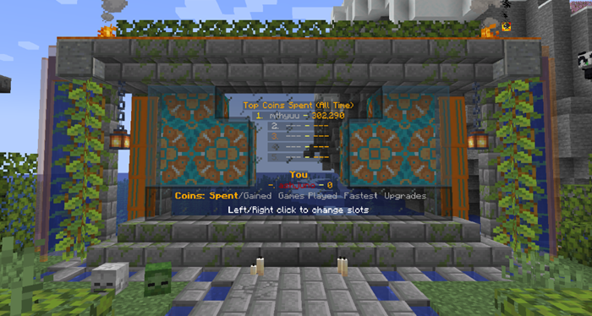
A&D – Database Connection
SQLite
Lightweight, free, and easy to implement
Game Data
Collected for User Concurrency and Data Tracking for the game's leaderboard system
Leaderboards
Gold Spent
Gold Gained
Games Played
Fastest Completion
Total Upgrades Bought

Slide 13
Development

Slide 14
Development – Planning & GDD
Project Plan
Timeline: Class & Sponsor tasks
Time Approximation: Gantt Chart
Generation Information: How to create the game
Meetings: Established team communication and sponsor meetings
Version Control: GitHub through the KSUBlocksTD Organization Account
Game Design Document
"Creating the project on paper"
Detailed game mechanics and how they would function
Rough ideas designed for maps, mobs, players, and overall gameplay
Commands and architecture of the game laid out
Resources and constraints required for our design
Notes:
In our project plan we had our timeline, that was mostly determined from the class checkins every week as well as the sponsor milestones that we had to adhere to. This helped us keep a steady pace when working on the project and helped us remember what actually needed to get done. To approximate our hours we used a gantt chart that we estimated our hours in then later filled in the actual hours spent. Our generation info which was basically a foundation of how we wanted to setup the game. We also established weekly sponsor meeting to allow for good communication for the people were making the project for. Version control is handled all in github.
For our game design document, we made sure we had the broad strokes of the game setup, like detailing the game mechanics we had in mind, how the maps should be laid out, ideas for towers and mobs among other gameplay mechanics. We also sketched how our command architecture would look and all our gameplay constraints

Slide 15
Development – Gameplay & Mechanics
Gameplay
Designed with the style of Bloons Tower Defense as the main source of inspiration for towers (from the Tower Defense genre)
Contains elements of player combat elements similar to Sanctum 2.
Mechanics
Players have limited hearts
Hostile mobs enter the map, follow the path, and remove hearts from the player should they reach the end.
Upon being defeated, they instead supply coins.
Players can set record scores to place themselves on the leaderboard
Players can build towers to combat mobs
Tower upgrades are generalized and focus on playstyles
Player combat can be expanded with upgrades and consumable items
Multiple maps can be selected with varying design elements and playstyles
Notes:
For our gameplay- we were inspired by tower defense games, but bloons TD6 specifically. The twist on our game however since it is in minecraft, is the player has direct control in damaging the mobs opposed to most tower defense games where the player is just watching towers do all the work.

Slide 16
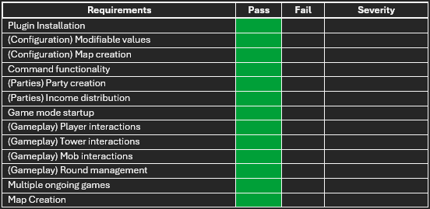
Development – STP & STR
Software Test Plan
How the project will be tested
Who will test what parts
What aspects are to be tested,
Where it will be tested.
The project was tested locally with all members of the team utilizing the testing table as seen.
As of project finalization, there were no issues found.

Slide 17
Finalized Items

Slide 18
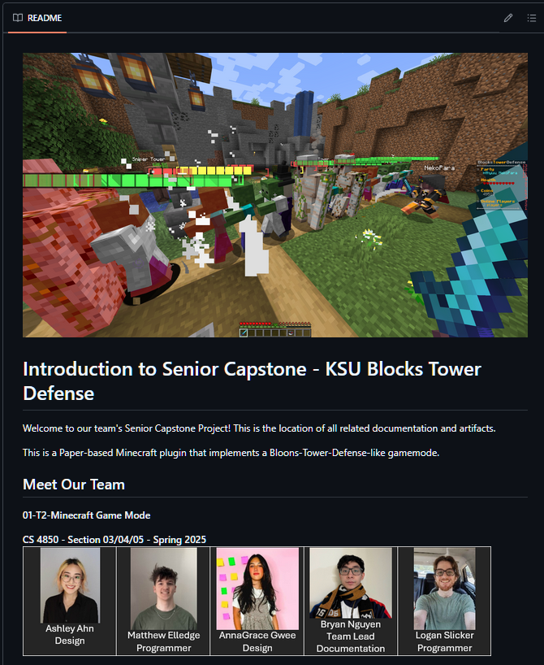
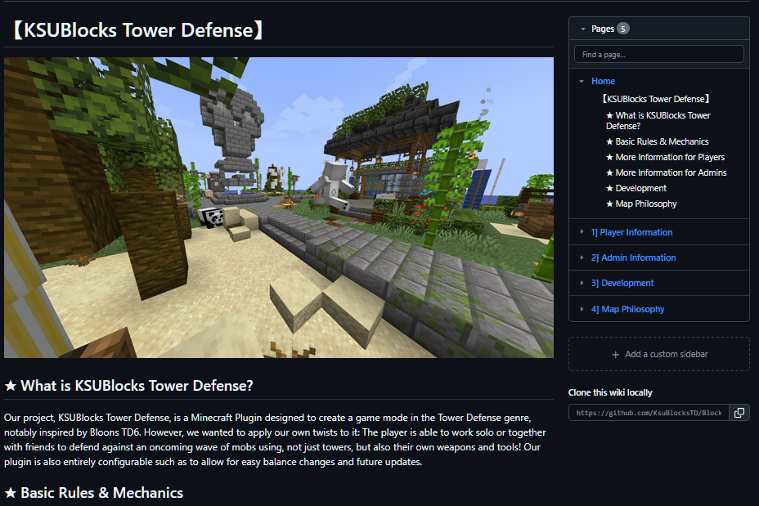
Finalized Items – GitHub Website
Our GitHub Home Page contains basic information on our project alongside all artifacts throughout the semester
Our GitHub Wiki Page contains a home page explaining the game alongside all documentation pertaining to players, admins, development, and map design.

Slide 19
Finalized Items – Completed Game
Video Not Present for GitHub’s File Size Limit Please Refer to the Youtube Video to See the Game Showcase

Slide 20


Conclusion
Through the usage of IntelliJ as our IDE alongside our plugins and APIs (such as Paper), we believe that we
accomplished our goal in implementing a fun and functional Tower Defense game that stands out in its genre and utilizes the Minecraft assets and functions well. We hope our project has longevity on the KSU Minecraft server and receives regular updates!
Discord Link to the KSU Minecraft Server: https://discord.gg/7xWVtaDvzK

